Slide 1
Brick Masonry
Building Construction and Practice

Slide 2
Brick Masonry
Brick masonry is a construction technique where bricks (typically clay or concrete) are laid in a predetermined pattern and bonded together with mortar to form walls or structures.

Slide 3
Technical terms in brick masonry
Brick: The basic unit of construction. Bricks can be laid in various orientations (e.g., stretcher, header) to create different bond patterns.
Typical Dimensions
Nominal Size: The most common nominal size for standard modular bricks (especially in India) is typically 190 mm × 90 mm × 90 mm.
Effective Size with Mortar Joints: When accounting for standard mortar joints (usually about 10 mm thick), the effective module becomes approximately 200 mm × 100 mm × 100 mm.

Slide 4
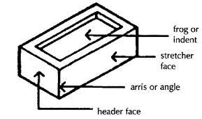

Slide 5
Brick Tiles in Short
Brick tiles are thin slices or replicas of traditional bricks, designed for use as decorative cladding on walls, floors, and facades. They provide the aesthetic appeal of brickwork without the weight and labor of full brick construction. Often available in various sizes, finishes, and colors, brick tiles are versatile, easy to install, and suitable for both interior and exterior applications.
Length: Approximately 190 mm to 200 mm
Width: Approximately 90 mm to 100 mm
Thickness: Typically between 10 mm and 20 mm (with 10 mm being common for lightweight applications)
These dimensions may vary based

Slide 6
Arris (Plural: Arrises)
In masonry and brickwork, an arris is the sharp edge formed by the intersection of two surfaces or faces of a brick or block.
Frog in Bricks
A frog is a depression or indentation molded into the face of a brick during its manufacturing process. Here are the key points:
Purpose:
Weight Reduction: The depression helps reduce the overall weight of the brick, making it easier to handle during construction.
Improved Bonding: The recess provides a key for the mortar, enhancing the mechanical bond between the brick and the mortar.
Material Efficiency: By reducing the volume of clay needed, frogs contribute to a more economical manufacturing process.

Slide 7
Brick on Bed
The term "brick on bed" refers to the standard practice in brick masonry where a brick is laid with its broad, flat face—known as the bed—in contact with the mortar. Here are the key points:
Orientation: The brick is positioned so that its largest, flattest surface (the bed) lies horizontally against the mortar joint. This is in contrast to laying the brick on its side (as a header) where a smaller face contacts the mortar.
Benefits:
Enhanced Bonding: The large contact area improves adhesion with the mortar.
Uniformity: Consistent placement contributes to uniform mortar joints and an even wall surface.
Structural Integrity: Laying bricks on their bed helps distribute loads effectively and enhances the overall strength of the masonry structure.
Application: This orientation is commonly used in standard wall construction, especially when employing bonds like the stretcher bond, where bricks are predominantly laid on their bed.

Slide 8
Brick on Side
The term "brick on side" refers to the practice of laying a brick with its narrowest face (side face) in contact with the mortar, meaning the larger bed face is placed vertically.
Key Points:
Orientation: The brick is turned so that its side face (90mm × 190mm in modular bricks) rests on the mortar, instead of the broader bed face.
Effect on Wall Thickness: This technique reduces the overall thickness of the wall, making it suitable for partition walls, lightweight constructions, and decorative works.
Common Uses:
Partition walls (Half-brick walls)
Non-load-bearing structures
Architectural patterns and decorative brickwork
Limitations: This orientation results in less structural strength compared to bricks laid on their bed, making it unsuitable for load-bearing walls.

Slide 9
Brick on End
The term "brick on end" refers to the practice of laying a brick with its smallest face (end face) in contact with the mortar, meaning the brick stands vertically with its height as the dominant dimension.
Key Points:
Orientation: The brick is placed upright, with its end face (90mm × 90mm in modular bricks) resting on the mortar bed.
Effect on Wall Thickness & Strength:
Increases wall height while keeping the footprint smaller.
Provides a distinct architectural appearance but offers less stability than traditional laying methods.

Slide 10
Common Uses:
Decorative brickwork and architectural patterns
Fencing and boundary walls
Piers and ornamental designs
Ventilated walls (perforated masonry work)
Limitations:
Not suitable for load-bearing walls due to reduced structural strength.
Requires careful mortar application for proper bonding.

Slide 11
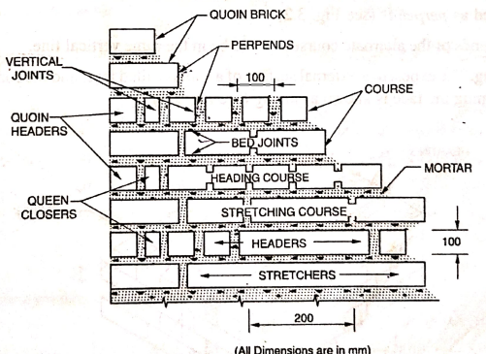
Course: A horizontal row of bricks in a wall.
Stretcher: A brick laid with its long face visible on the wall.
Header: A brick laid with its short end exposed on the wall.
Quoin: The external corner of a wall, often finished with a distinct pattern or treatment.

Slide 12
Bed Joint: A bed joint in brick masonry refers to the horizontal layer of mortar placed between two courses (rows) of bricks.
Key Points:
Definition: It is the mortar joint that supports the bricks laid above it.
Thickness: Typically 10 mm (as per standard construction practices).
Purpose:
Provides bonding between layers of bricks.
Distributes load evenly across the masonry structure.
Helps in alignment and leveling of bricks.
Enhances water resistance by filling gaps and reducing permeability.
Types:
Full Bed Joint: Covers the entire brick surface for strong bonding.
Hollow or Thin Bed Joint: Used in some specialized construction to reduce mortar consumption.

Slide 13
Cross Joints
A cross joint is a vertical mortar joint between two adjacent bricks in the same course (row) of brick masonry.
Key Points:
Also Known As: Perpend joint
Purpose:
Provides bonding between bricks.
Ensures load transfer across the wall.
Helps in alignment and stability of masonry.
Standard Thickness: Typically 10 mm (as per construction standards).

Slide 14
Hearting in Brick Masonry
Hearting refers to the inner portion or core of a brick masonry wall that is filled with mortar and smaller brick pieces to ensure stability and strength.
Key Points:
Located between the faces of the wall.
Ensures solid bonding and prevents voids inside the masonry.
Properly filled hearting enhances strength and durability.

Slide 15
Bats in Brick Masonry
A bat is a portion of a brick that is cut lengthwise to adjust brickwork dimensions or fit specific construction needs.
Types of Bats:
Half Bat – A brick cut into two equal halves along its length.
Three-Quarter Bat – A brick with three-fourths of its original length.
Quarter Bat – A brick with one-fourth of its original length.
Bevelled Bat
Uses:
Filling gaps in masonry.
Adjusting brick courses to maintain bond patterns.
Creating corners or junctions in walls.

Slide 16
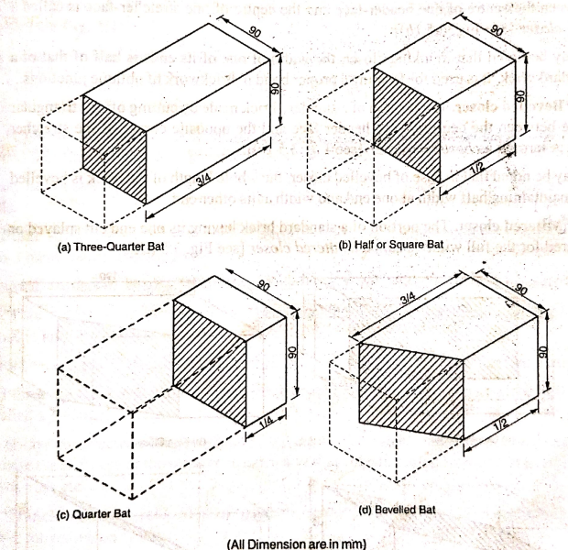

Slide 17
Closer in Brick Masonry
A closer is a cut portion of a brick used at the ends of courses to maintain the bond pattern and ensure proper wall alignment.
Types of Closers:
Queen Closer – A brick cut lengthwise into two equal halves.
King Closer – A brick cut diagonally from the center to one corner.
Bevelled Closer – A brick cut diagonally from the center to the middle of one end.
Mitred Closer – A brick with one end cut at an angle other than 90°.
Uses:
Placed at wall corners or junctions for proper bonding.
Prevents vertical joint alignment, improving strength.
Enhances structural stability and uniformity.

Slide 18
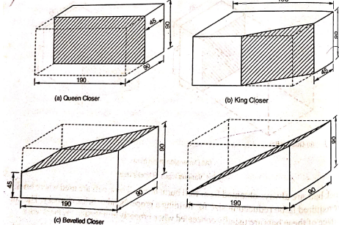
(d) Mitered Closer

Slide 19
Plinth Level
The level between the ground and the start of the superstructure of a building.
It is the top of the plinth course, where the walls of the main structure begin.
Usually 300mm to 600mm above ground level, depending on site conditions.
Purpose:
Protects the building from moisture, waterlogging, and termite attacks.
Provides a stable base for the superstructure.
Helps in leveling uneven ground.

Slide 20
Stanchion
A stanchion is a vertical structural support used in buildings, commonly made of steel, concrete, or wood.
Key Points:
Functions as a column or post to support beams, roofs, or floors.
Used in steel structures, scaffolding, fences, and handrails.
Provides load-bearing stability in construction.

Slide 21
Mortar
Mortar is a mixture of sand, water, and binder (usually cement, lime, or a combination) used in masonry construction to bond bricks, stones, or blocks together.
Key Points:
Function:
Acts as a binding agent between building materials.
Provides structural stability, insulation, and waterproofing properties.
Composition:
Cement mortar (cement, sand, water).
Lime mortar (lime, sand, water).
Mud mortar (used in traditional and rural construction).
Types:
Thick mortar for load-bearing applications.
Thin mortar for aesthetic and non-load-bearing work.

Slide 22
Types of Masonry Bonds
1. Brick Bonds
Stretcher Bond – Bricks laid lengthwise in all rows.
Header Bond – Bricks laid with their short side (header) facing out.
English Bond – Alternating rows of stretchers and headers.
Flemish Bond – Alternating stretchers and headers within the same row.
Rat Trap Bond – Bricks arranged to create a hollow cavity for insulation.

Slide 23
Raking Bond
English Cross Bond
Hoop Iron Bond
Facing Bond
Dutch Bond
Monk Bond
Zig Zag Bond
Brick-on-Edge Bond
Silverlock’s Bond

Slide 24
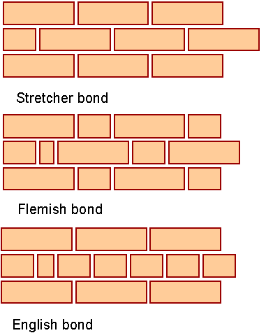
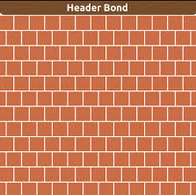
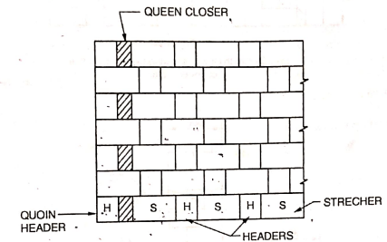
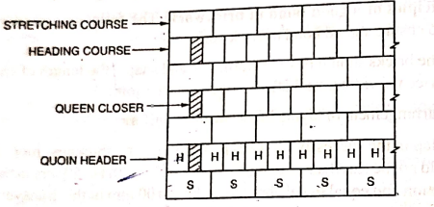
English Bond
Flemish Bond

Slide 25
Double Flemish Bond
A Double Flemish Bond is a brickwork pattern where both the front (face) and back sides of the wall show an alternating arrangement of headers and stretchers in each course.
Advantages:
Provides good strength and aesthetic appeal.
Uniformity in the pattern on both sides.
Disadvantages:
More skilled labor required.
More time-consuming and expensive compared to English Bond.

Slide 27
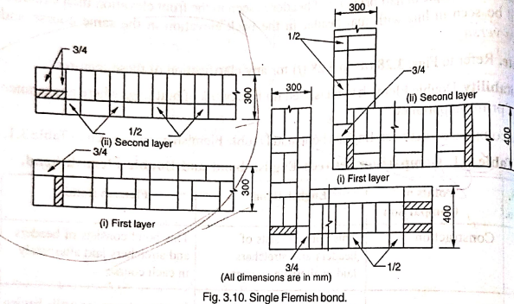

Slide 28
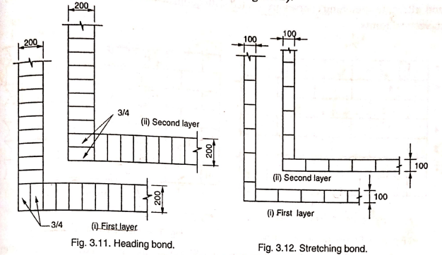

Slide 29
